Slide 1
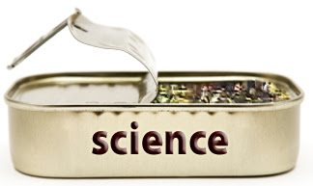
Doing Open Science
Lorne Campbell
With inspiration and ideas from colleagues Etienne LeBel & Timothy Loving

Slide 2
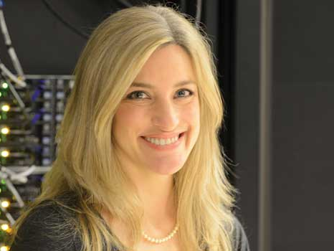
I am Inclined to simply show this talk by Victoria Stodden: https://www.youtube.com/watch?v=sZIxzTsvWhw

Slide 3

Why Should Science Be Open?
Evaluation requires understanding the methods used
Reproducibility
Replicability

Slide 4
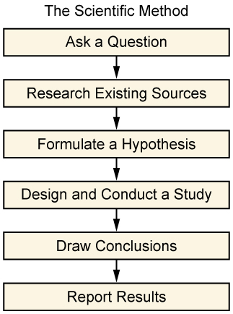

Slide 5
When to Share?
What to Share?

Slide 6
Donoho (via Stodden): The
published paper is only an
advertisement of the
scholarship; it is not the
scholarship itself

Slide 7
Retrospective Reporting

Slide 8
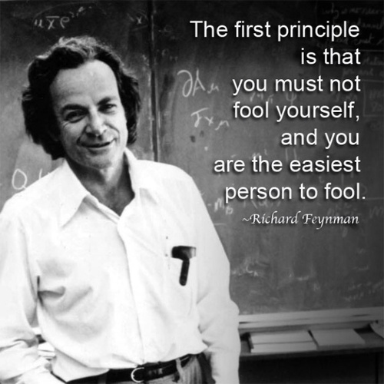

Slide 9
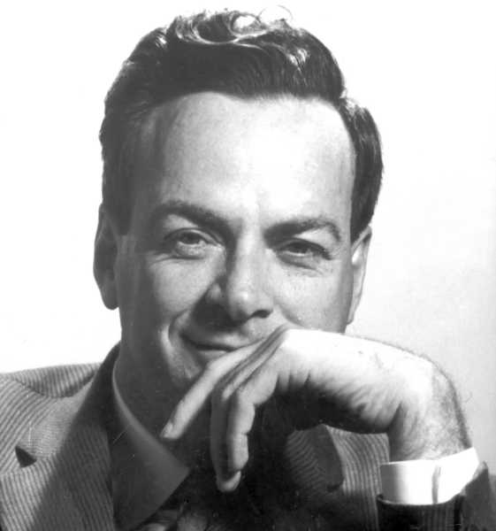
Feynman on Vague Theories
They are good because they can never be proven wrong!

Slide 10
Theory Building
Requires testing “risky predictions” (Meehl, 1967, 1978)
Risky prediction: hypothesis that stands a high chance of being wrong (Feynman, 1974; Popper, 1959)

Slide 11
But…
Deutsch & Krauss (1965)—social psychological theories rarely dictate specific hypotheses
Theory testing in psychology is hard
Requires more truly confirmatory research (Schaller, 2015; Simpson, 2013)

Slide 12
Not all Research is Confirmatory
Non-specific hypotheses
Follow data patterns
This type of discovery is important, but…
Share how the results were obtained (Wigboldus & Dotsch, 2015)

Slide 13

Doing Open Science
We receive a lot of training on research methods and statistical procedures (but likely not enough—another talk!)
But, not much (if any) on how to do open science
Technology today allows for open science practices

Slide 14

What to do?

Slide 15
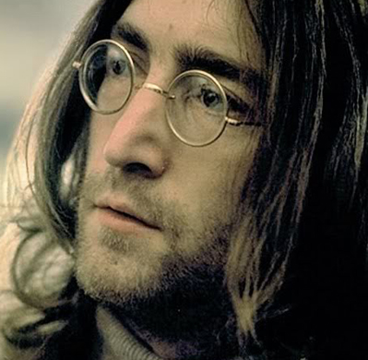
Challenges, not Roadblocks
“Well I tell them there’s no problem, only solutions”

Slide 16
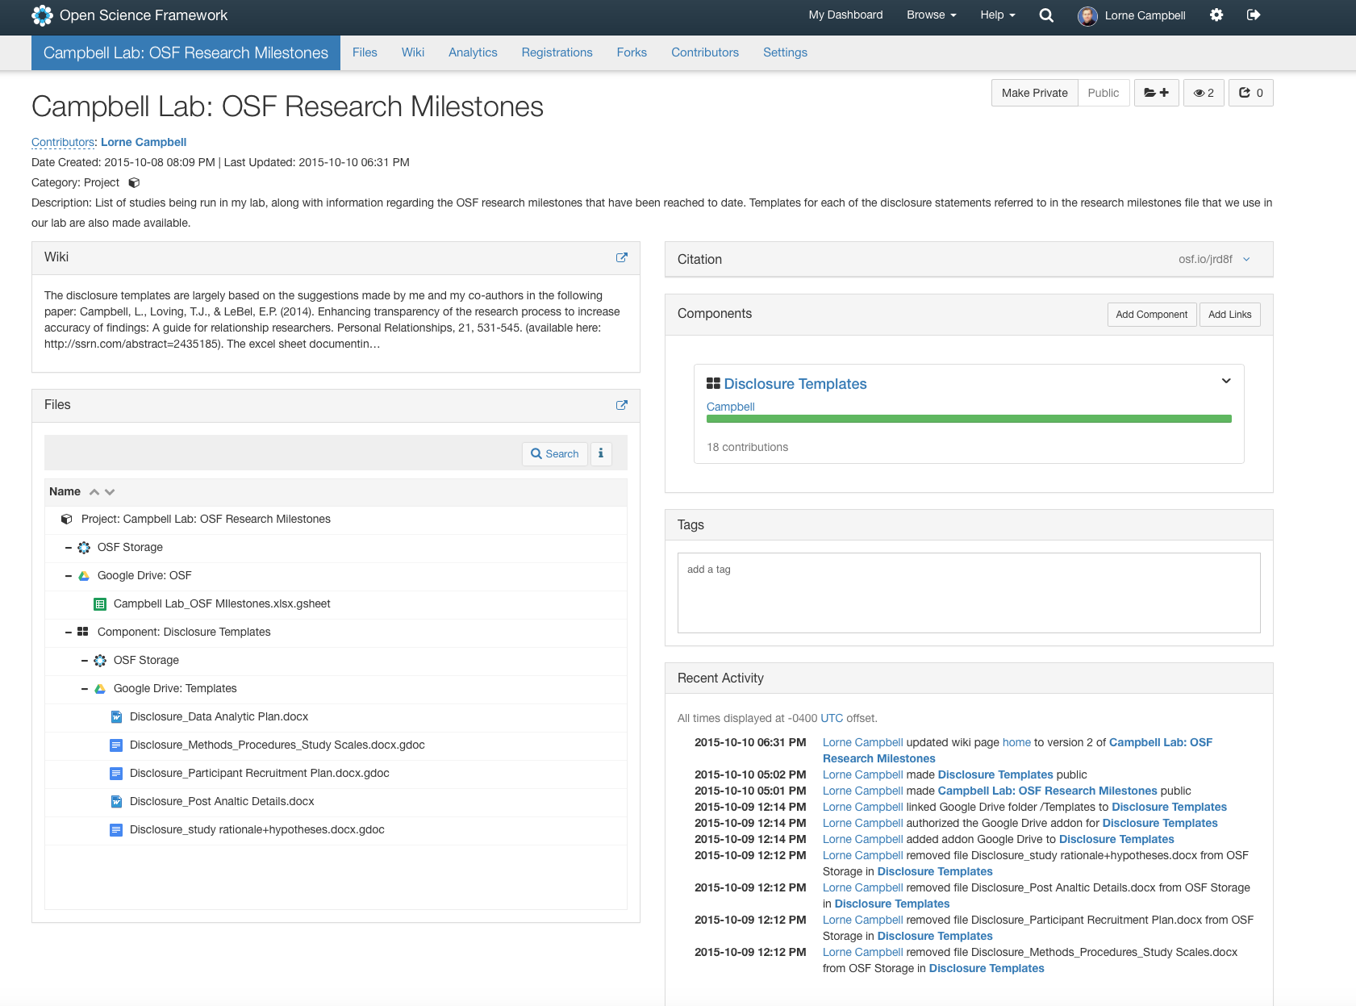

Slide 17
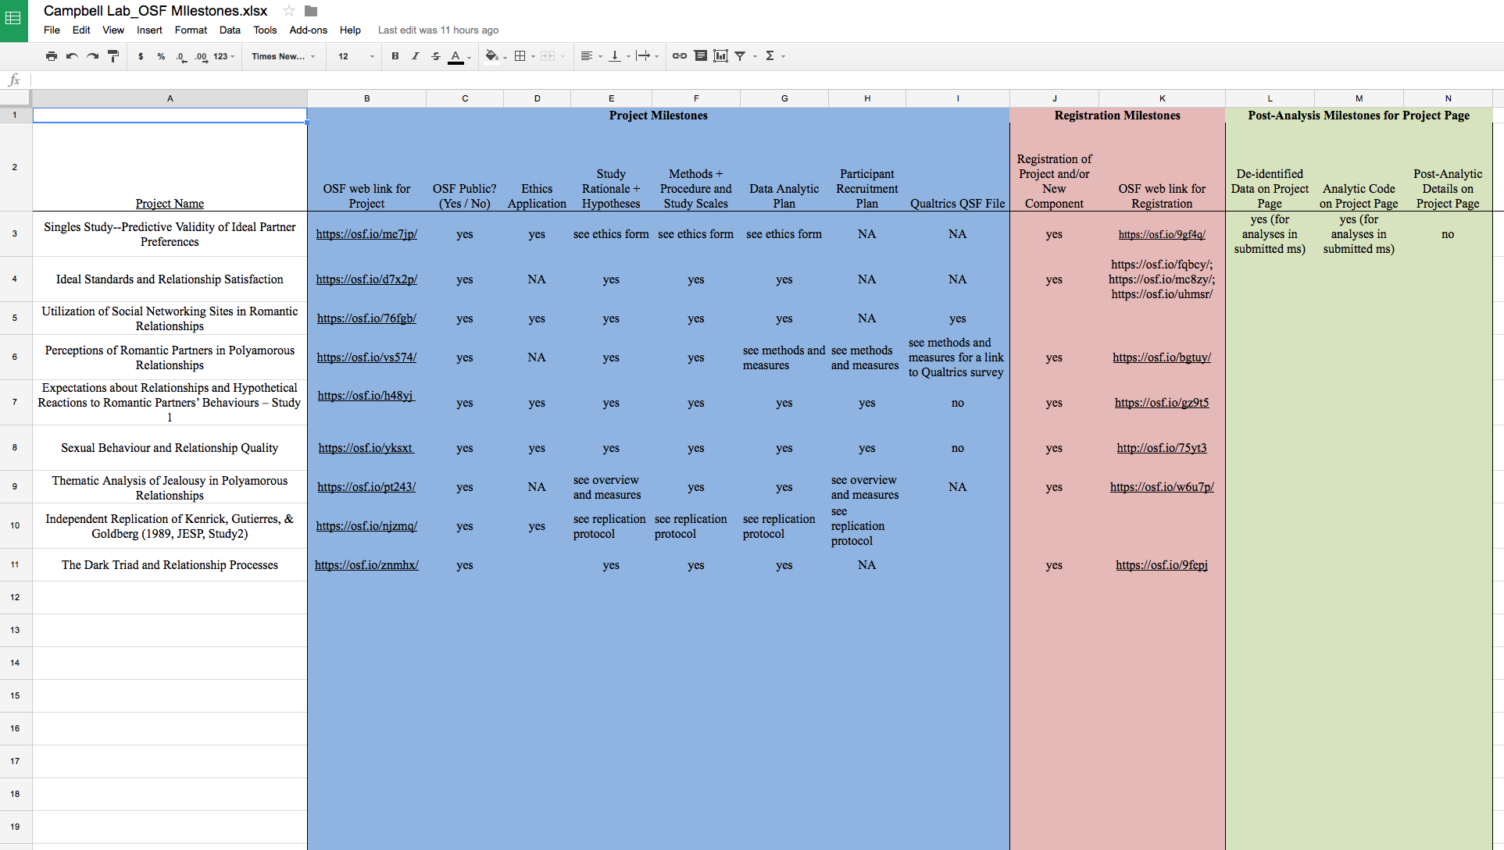

Slide 18
Disclosure Statements
Study Rationale & Hypotheses
Methods, Procedures and Study Scales
Data Analytic Plan
Participant Recruitment Plan (if applicable)
Post-Analytic Discussion

Slide 19
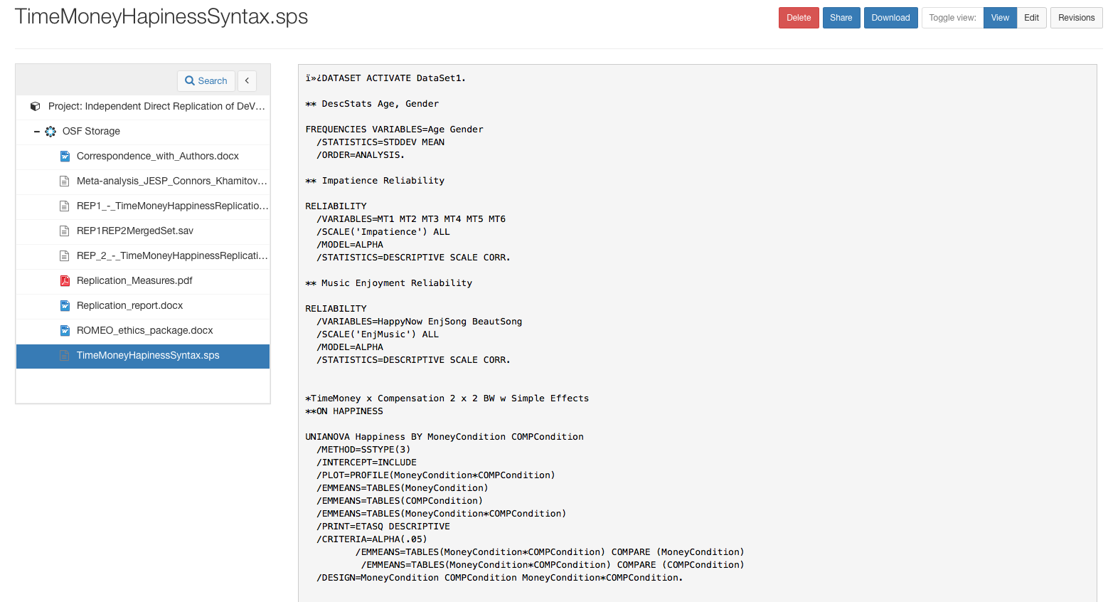

Slide 20
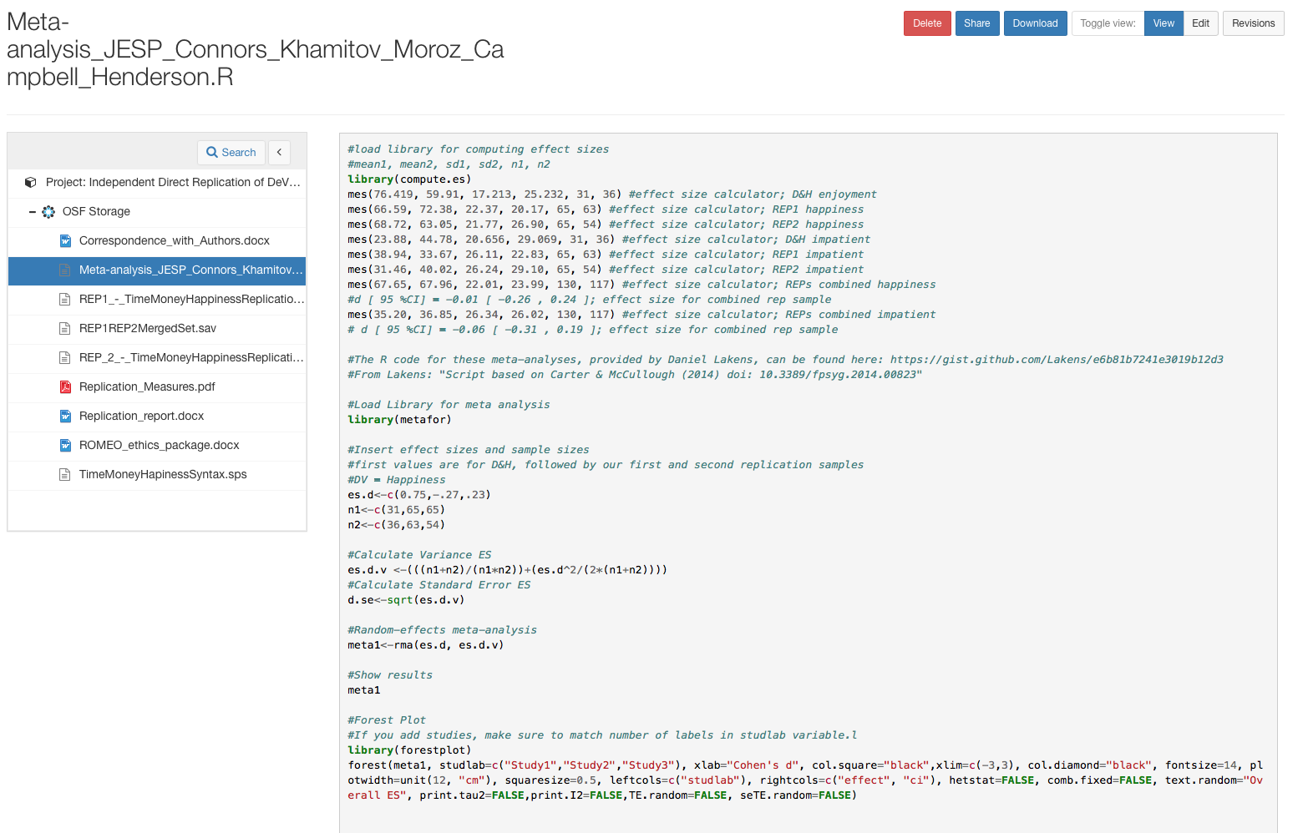

Slide 21
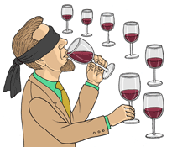
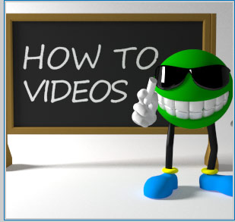
What Else?
Blind Analysis
Methods Videos

Slide 22
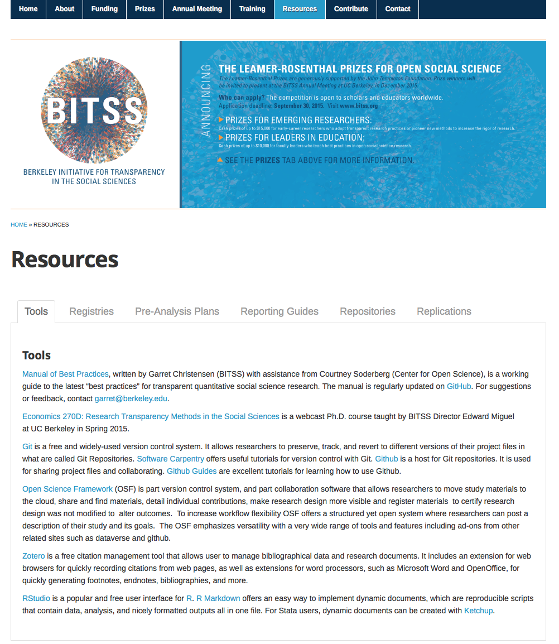

Slide 23
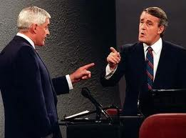
“You Had an Option, Sir”
We all have the option to adopt open, or closed, research
practices; it is our choice. When deciding what option to choose, ask
yourself if that is the best choice for advancing scientific discovery.
We have the obligation of sharing our choice for open or closed
research practices.

